Slide 1

Trending Arabic words from Twitter

Slide 2
The Problem
Trending topics in the Arabic language.

Slide 3
What we used
Twitter API – (user id, text)

Slide 4

Questions answered
What is Saudi Arabia's trending topic in Arabic in the last 10 days?
What is Egypt's trending topic in Arabic in the last 10 days?
What is <Country> trending topic in Arabic in the last 10 days?

Slide 5
Tools used in this project
Pandas
Matplotlib
Nltk
arabic_reshaper
bidi.algorithm
request

Slide 6
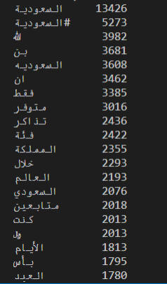
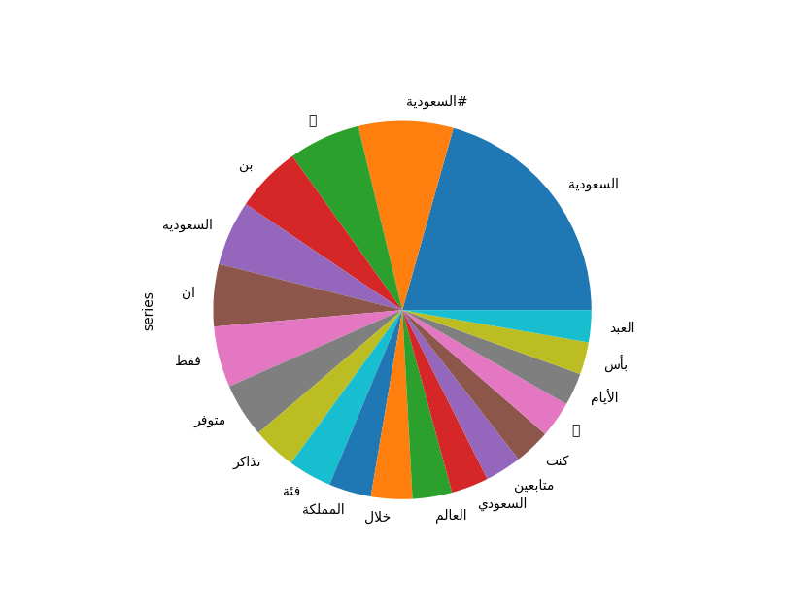
Results

Slide 7
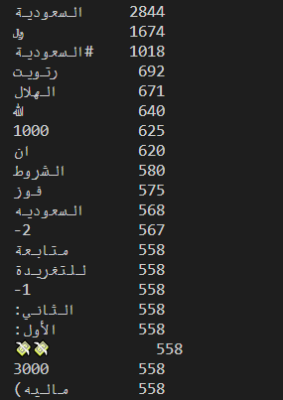
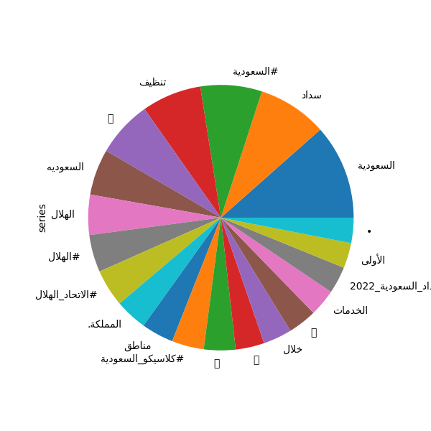

Slide 8
